Slide 1
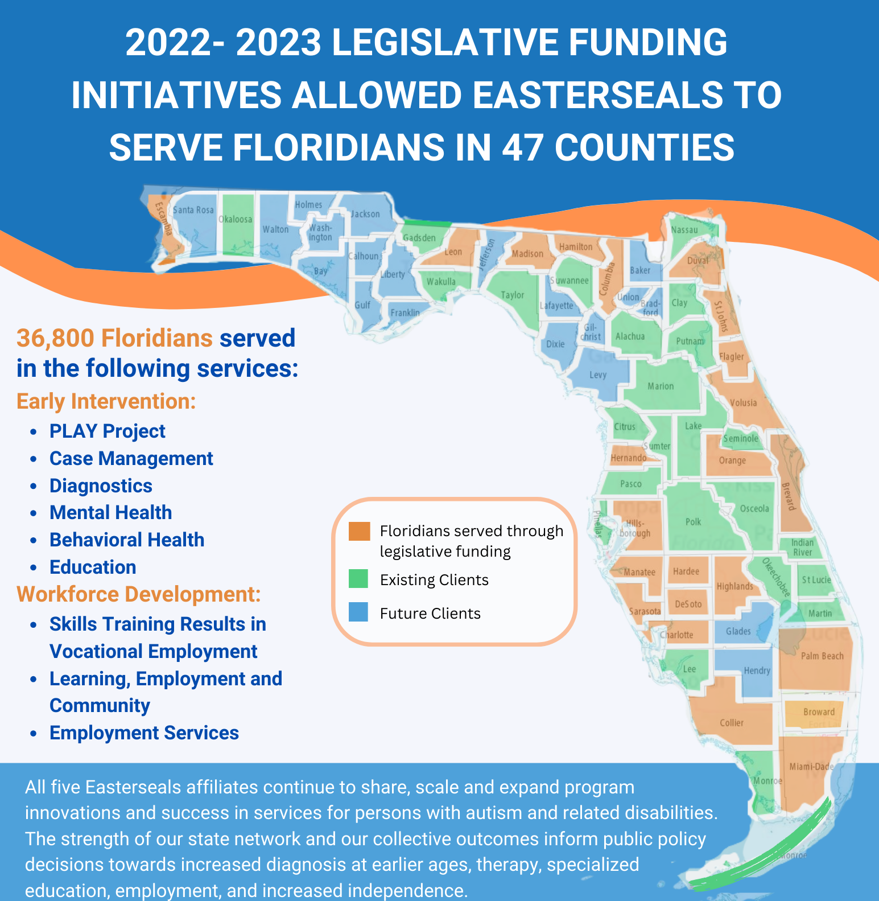

Slide 2
The Who
MORE THAN
Serving individuals 6-weeks-old to senior citizens.
With physical, intellectual, and developmental disabilities (I/DD).
75yrs
Notes:
Tom

Slide 3


The What
Enriching education
  Preschool (6-weeks to 5-yrs-old)
  Elementary, Middle, and High School
    (up to age 22)
Enhancing health
  Therapy (PT, OT, Speech, ABA, EI)
  Diagnostics
  Pediatric Medicine
  Mental Health
  Equine Therapy (Hippotherapy)
Expanding employment
  Life Skills
  Virtual Reality
Elevating community
  Adult Enrichment
  Learn and Grow Garden
  Case Management
  Support Groups
Notes:
Nicole

Slide 4


S. T. R. I. V. E.
Skilled Training Resulting In Vocational Employment
Curriculum based on the American Hotel and Lodging Educational Institute standards, students earn a certification when complete from AHLEAI
Teaches skills to students ages 15 and up
Classes taught in multiple schools through on-line and in person methods
Skills include guest room attendant, breakfast attendant, maintenance employee, front desk representative, and guest services
Three years strong and continually growing

Slide 5
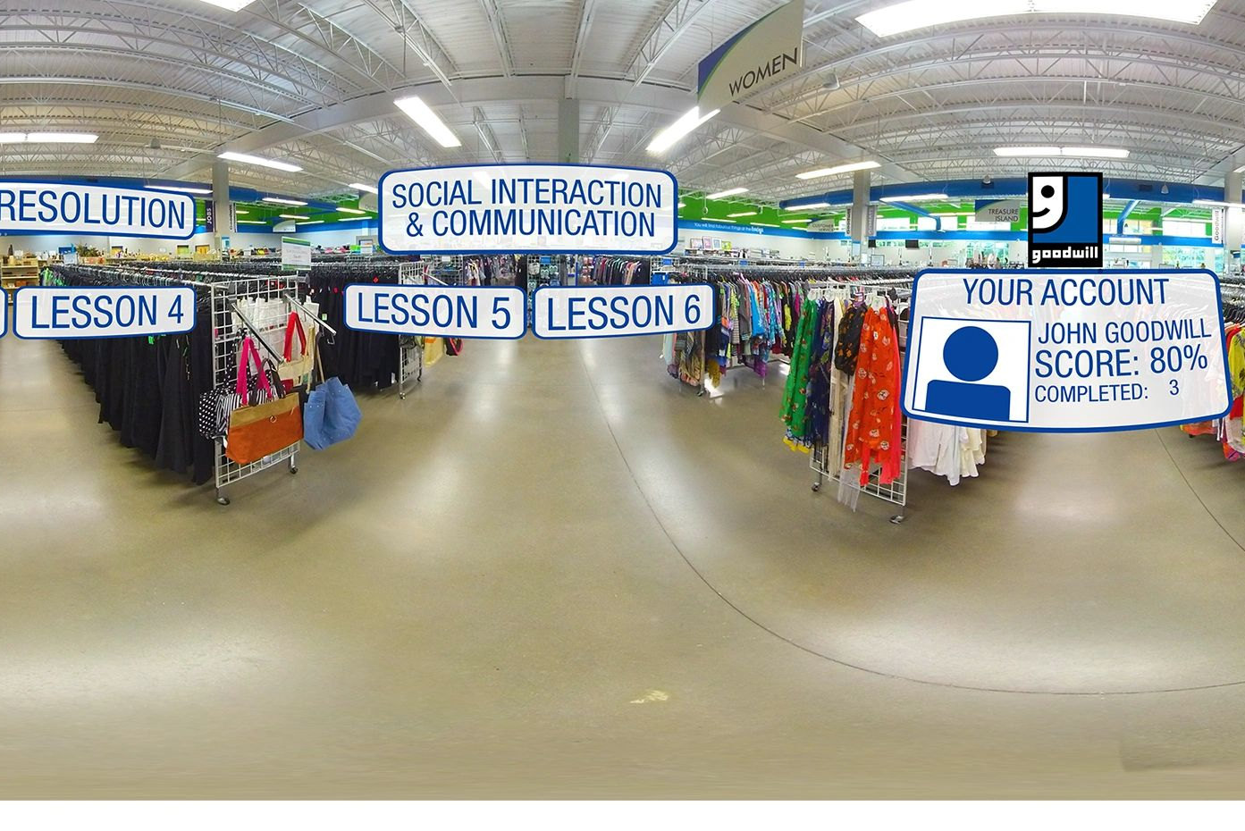
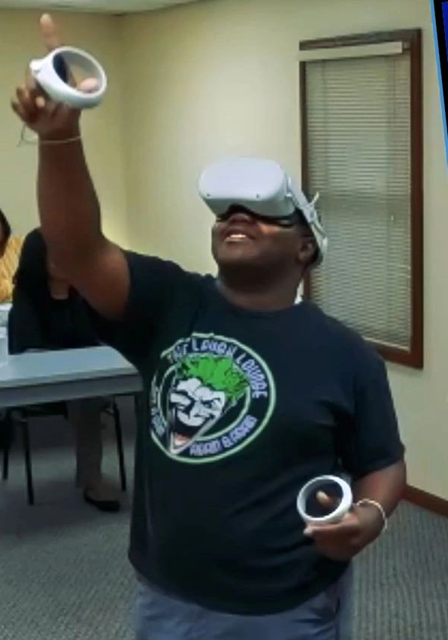

Virtual Reality // VR

